Slide 1
Jira & Testomatio
Bugs & User Stories linked with issues in Jira
Agoda – Booking hotels and air tickets
https://www.agoda.com/

Slide 2
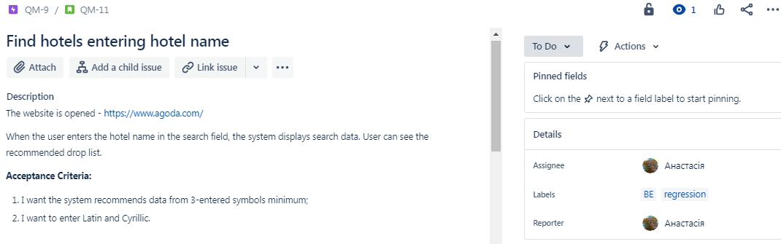
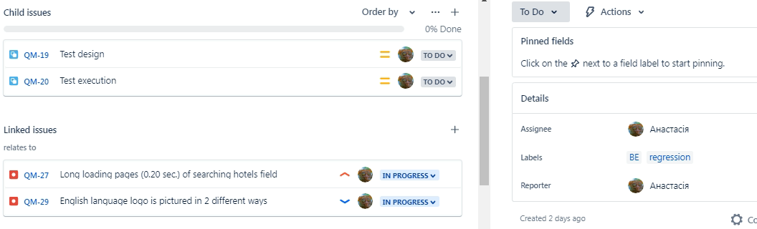
Jira linked with Testomatio

Slide 3
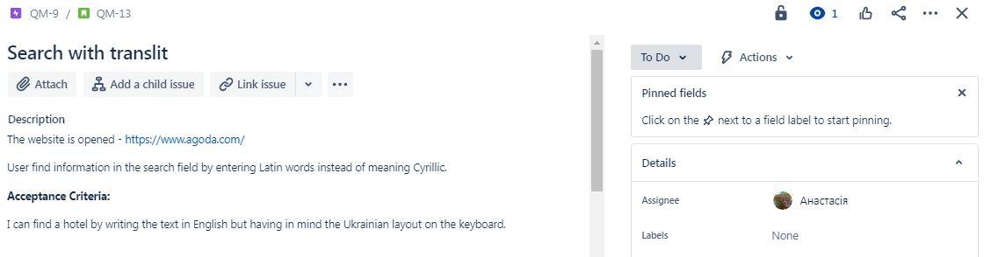
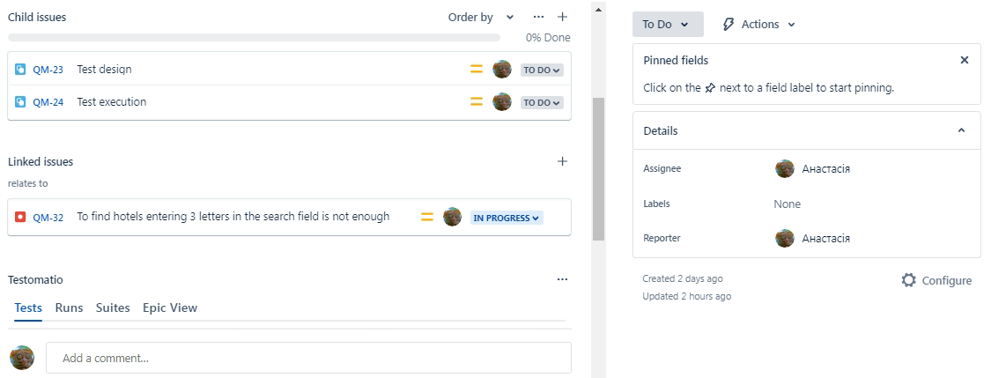
Jira linked with Testomatio

Slide 4
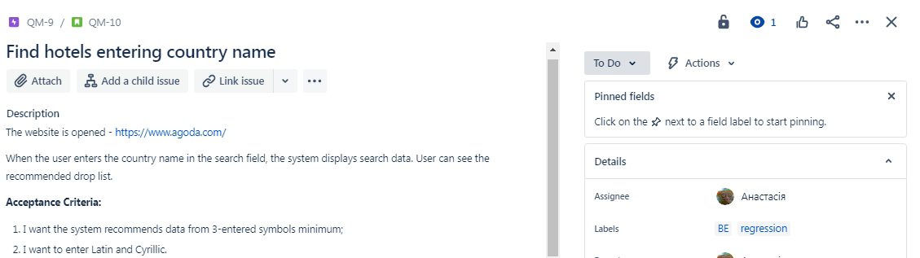
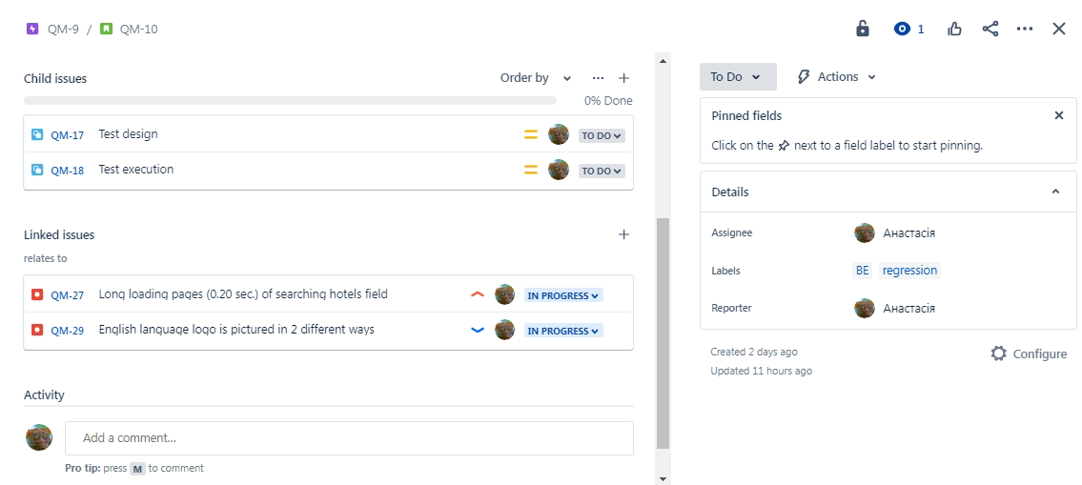
Jira linked with Testomatio

Slide 5
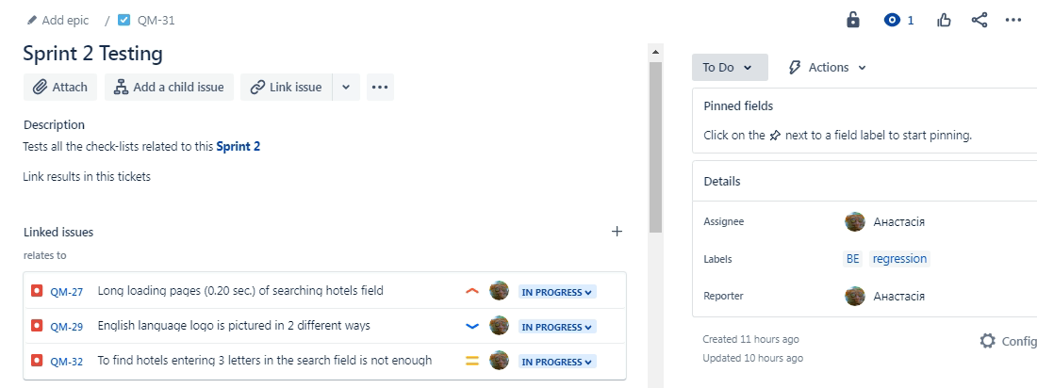
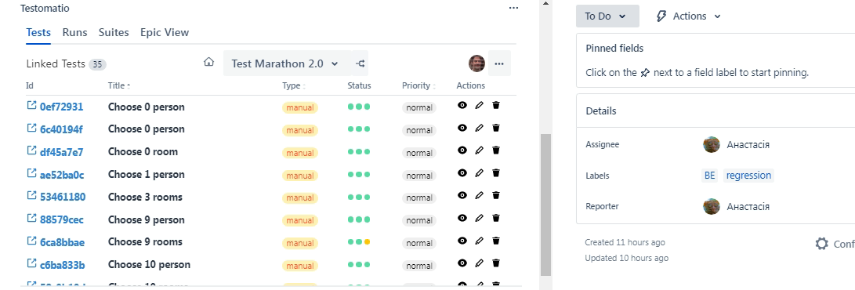

Slide 6
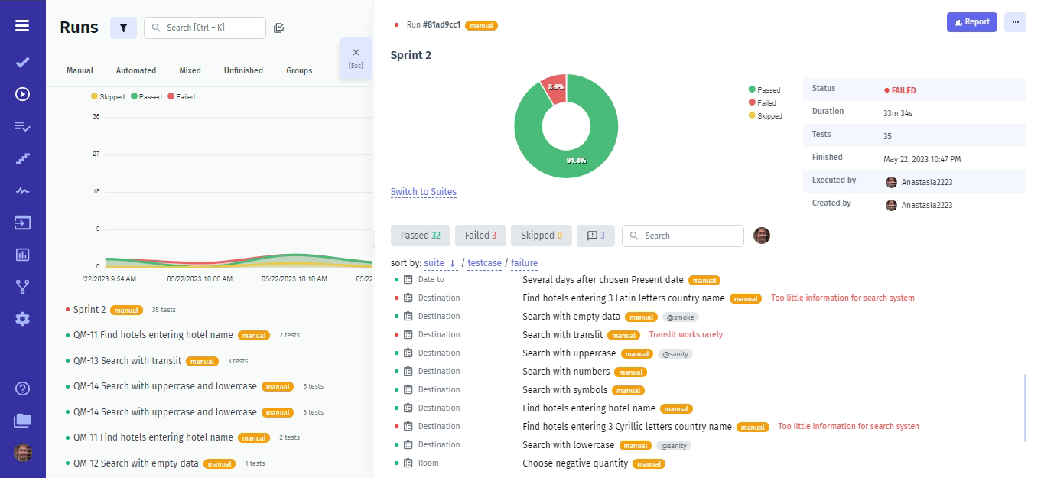
Test run Testomatio link in the next slide

Slide 7
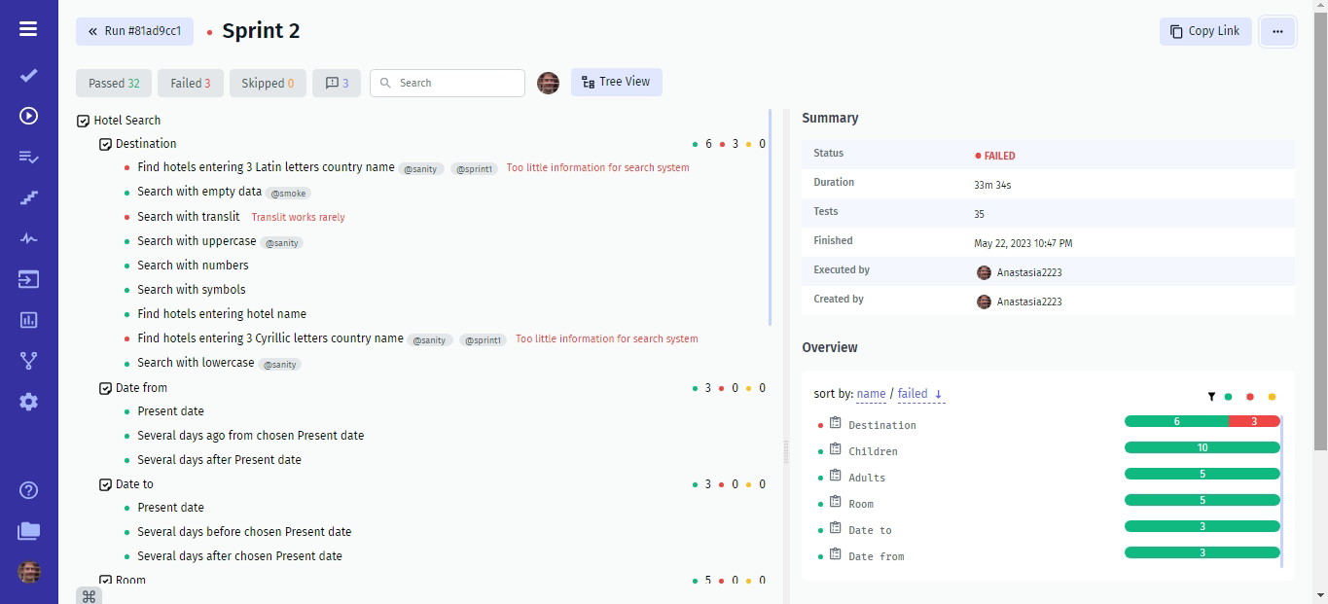
URL report - https://app.testomat.io/report/81ad9cc1/7023f317-a06a-4047-a22b-24a8351bd94d

Slide 8
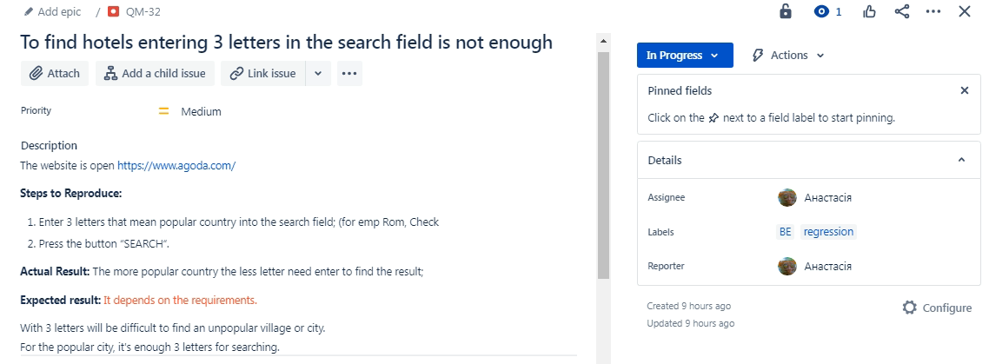
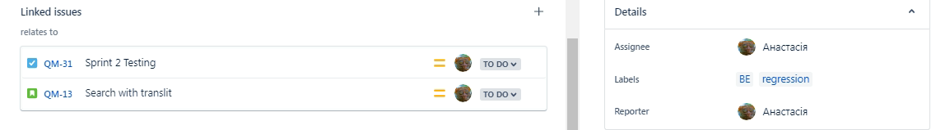
Bug with linked issues

Slide 9
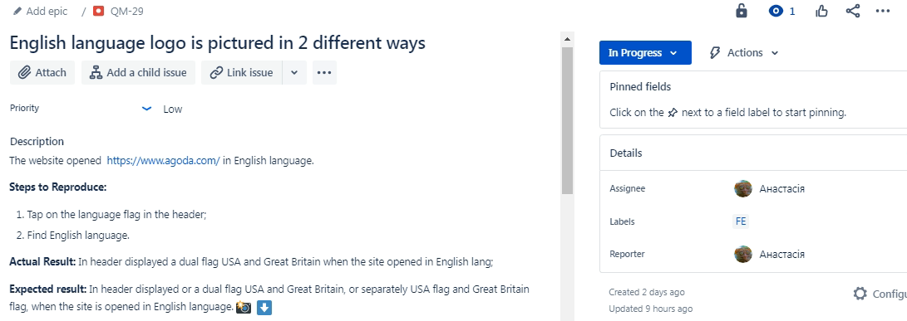
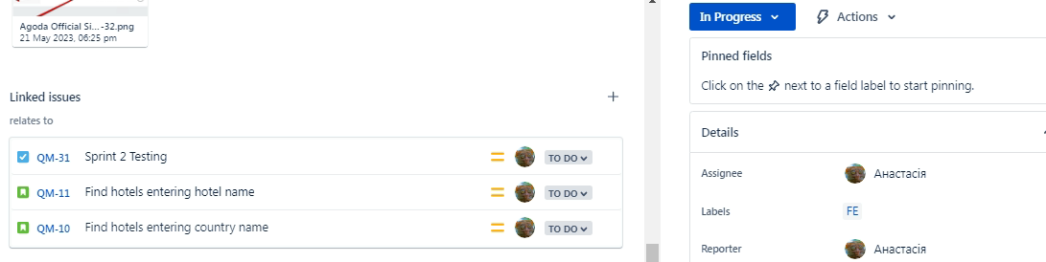
Bug with linked issues

Slide 10
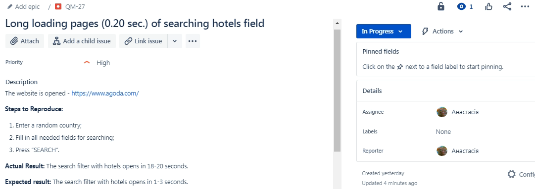
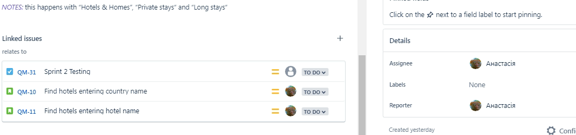
Bug with linked issues

